Slide 1
DEMO DASHBOARDS

Slide 2
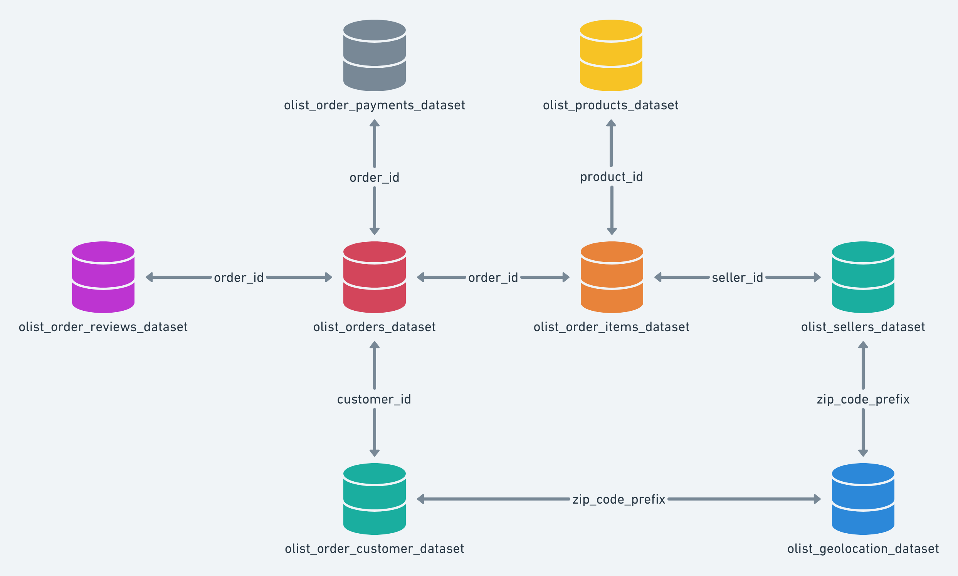
Datasets Overview
In total there are 8 datasets given which are Interlinked to each other as shown

Slide 3
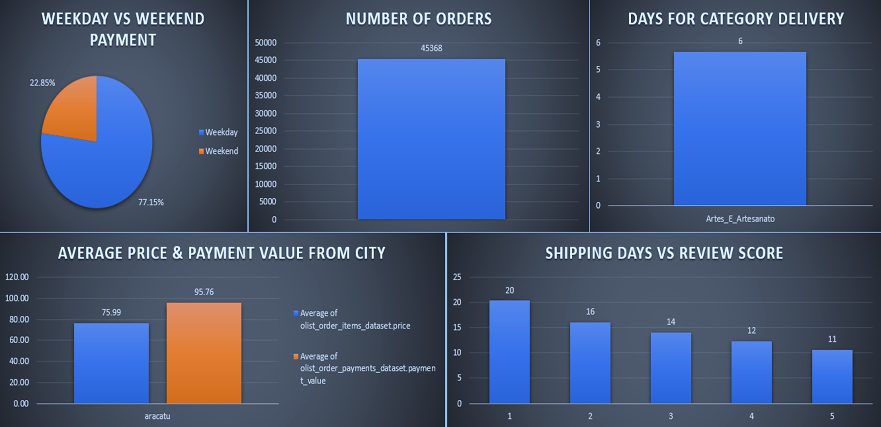

Slide 4
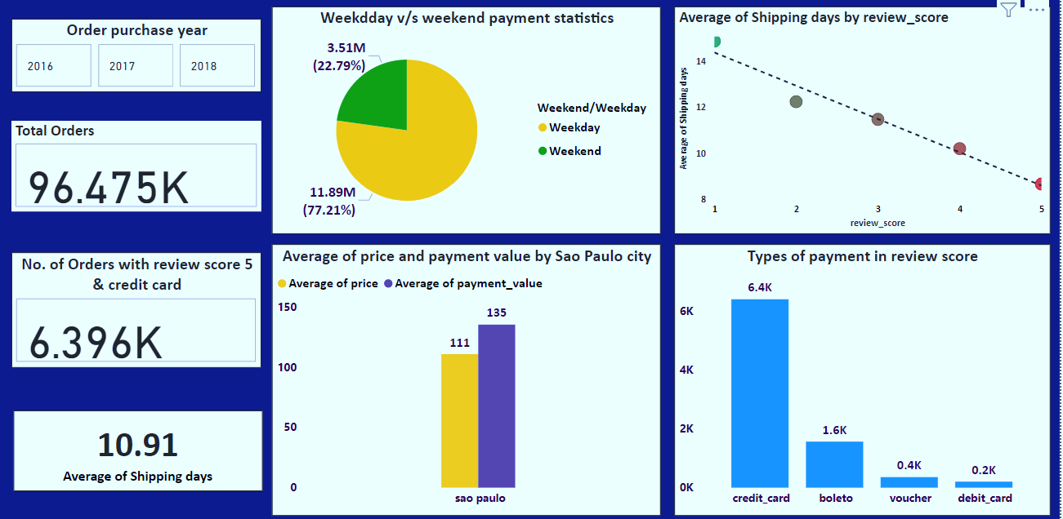
POWER BI DASHBOARD

Slide 5
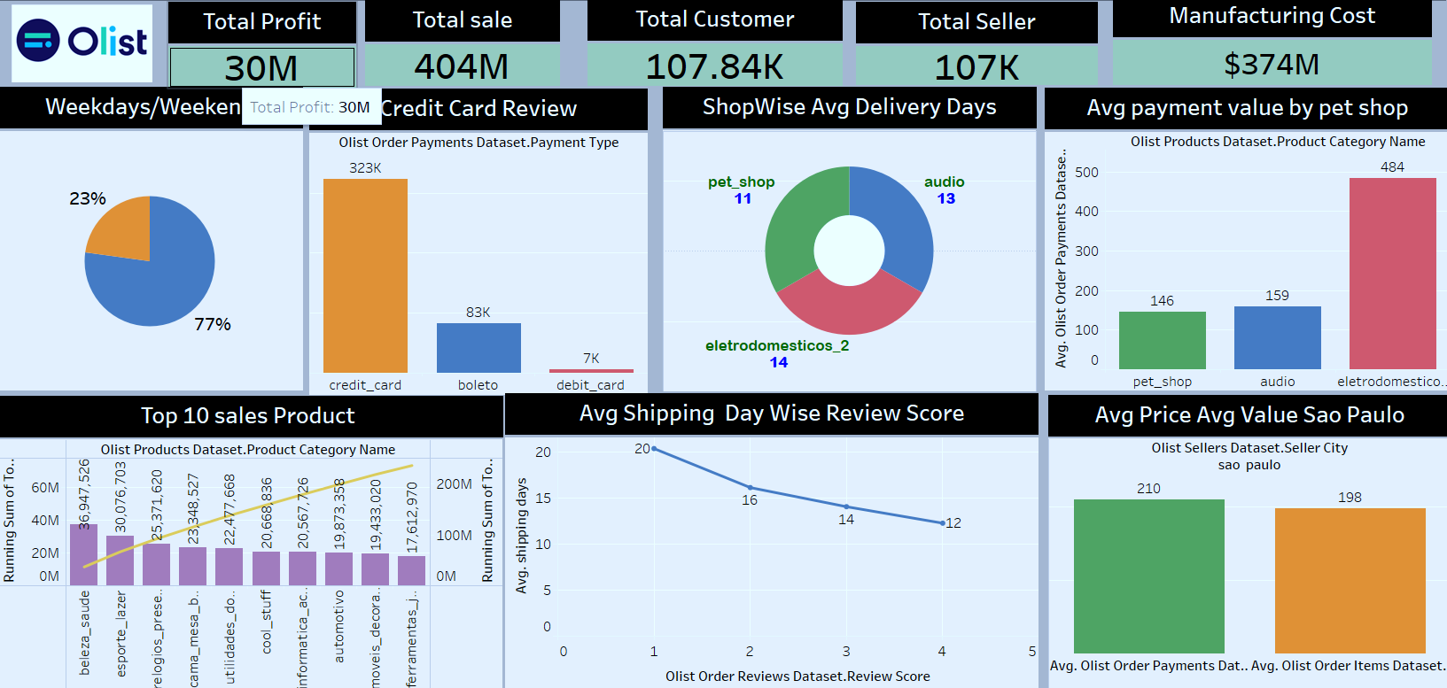

Slide 6
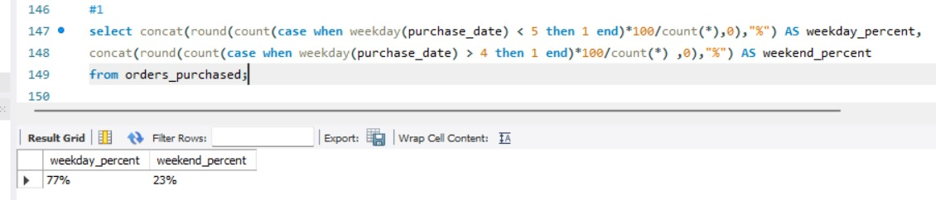
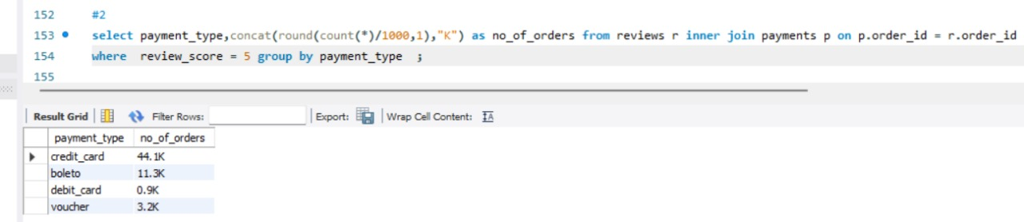
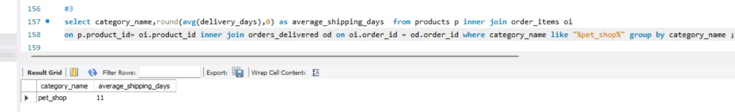
SQL QUERIES
1)
2)
3)

Slide 7
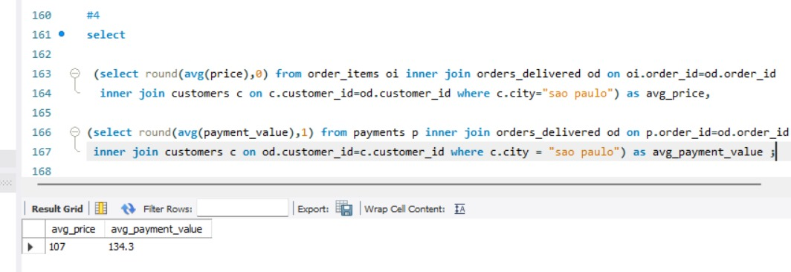
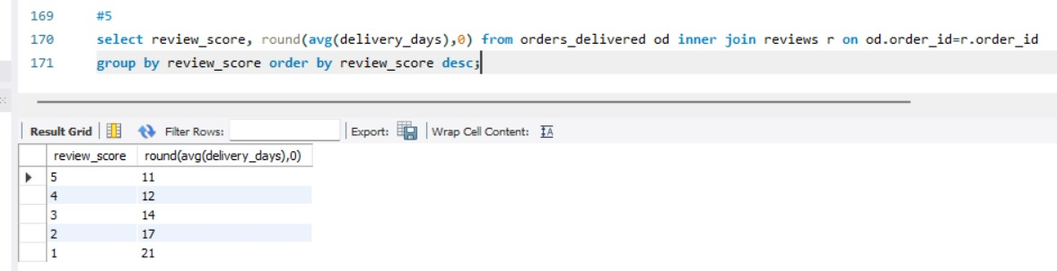
4)
5)

Slide 8
THANK YOU

